Slide 1
天才腦GENIUS&秀才腦
幼兒篇https://www.youtube.com/watch?v=AMZzWcJiJGY
小學波動速讀篇https://www.youtube.com/watch?v=-88v3liD6pI&t=1s
天才與秀才篇https://www.youtube.com/watch?v=-v4avh82StY&t=3s
https://www.facebook.com/hegurutaiwan/?locale=zh_TW

Slide 2


Slide 3


Slide 4
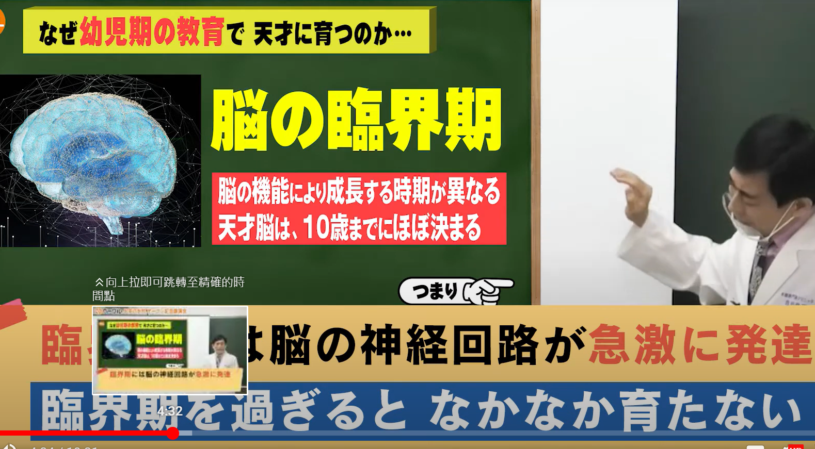

Slide 5
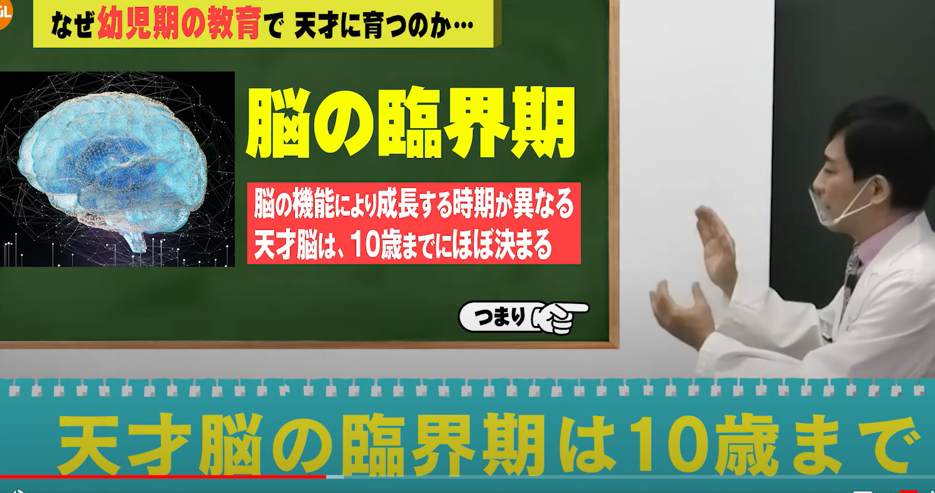

Slide 6
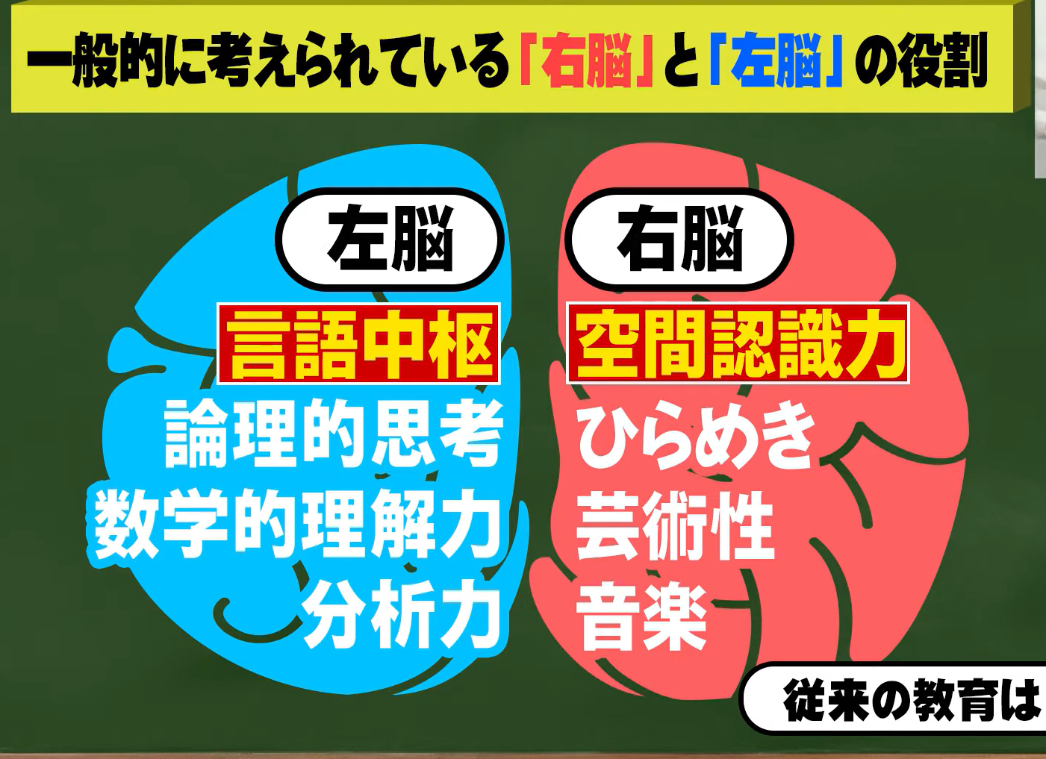

Slide 7


Slide 8


Slide 9
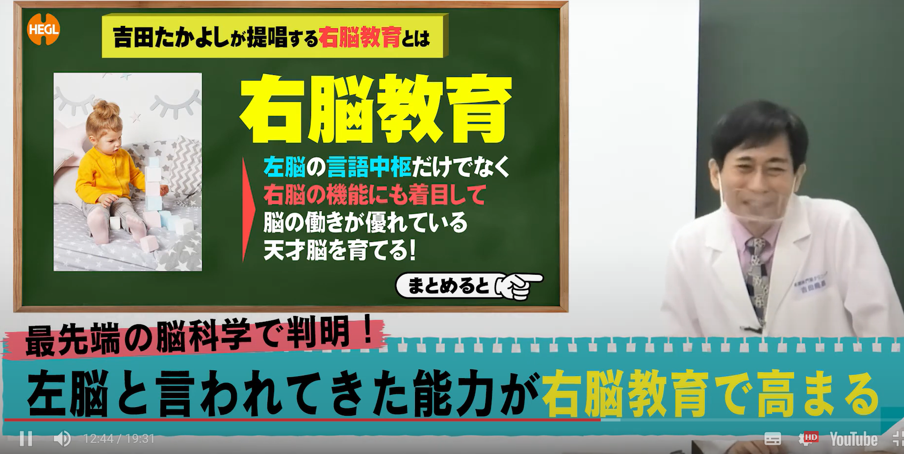

Slide 10
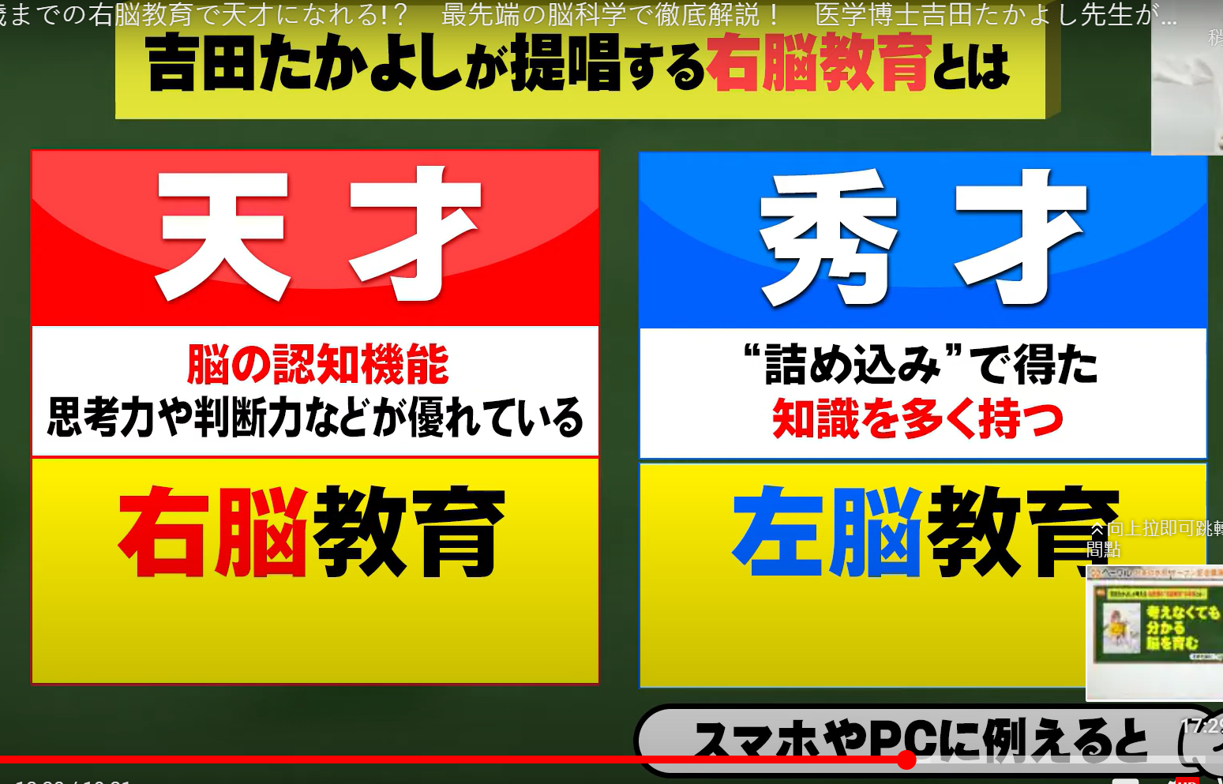

Slide 11


Slide 12
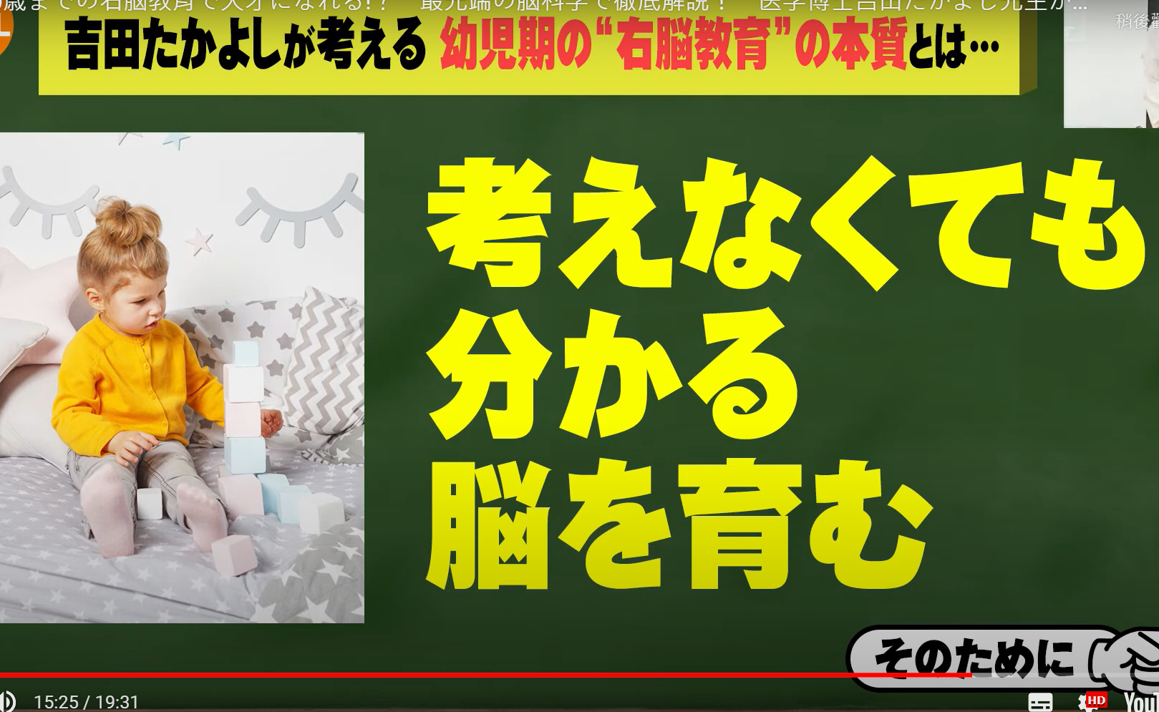

Slide 13
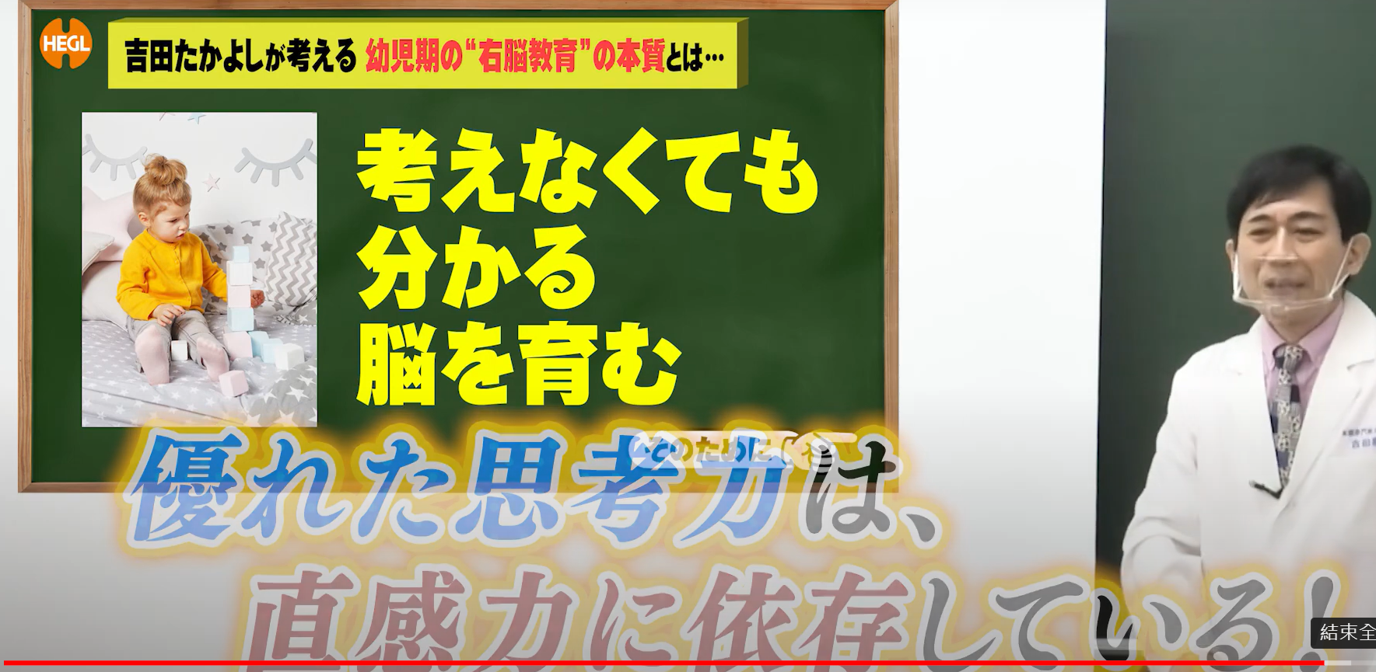

Slide 14
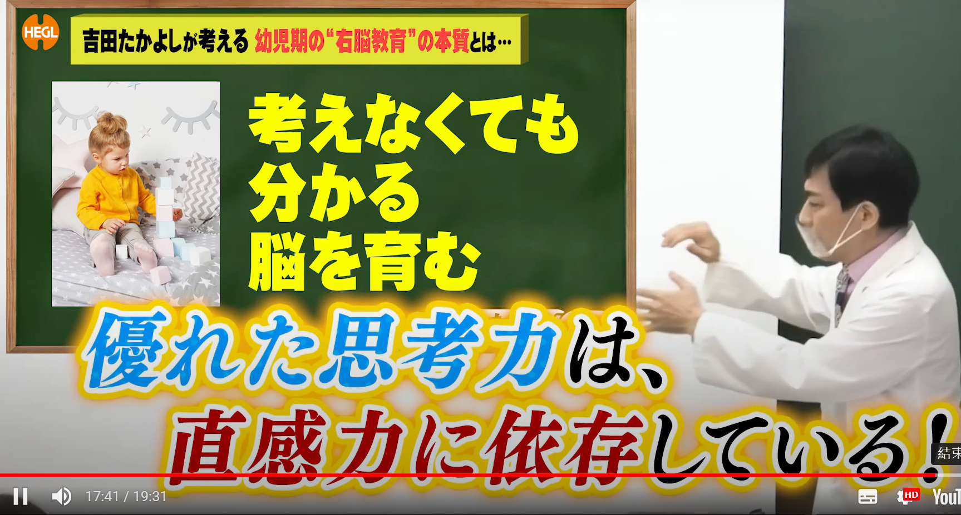

Slide 15


Slide 16
